Slide 1
Coding and Decoding
VIGNESH M

Slide 2
1) If in a certain language KINDLE is coded as ELDNIK, how is EXOTIC coded in that code?
a) EXOTIC b) EXOTLC c) CITOXE d) COXITE e) None of these
2) In a certain code BREAK is written as ASDBJ.How is SOLAR written in that code?
a) RPKBS b) TPMBS c) RPKBQ d) TPKBQ e) None of these
3) In a certain code ’GONE’ is written as ’NOEGG’ and ’LOAD’ is written as ’AODLL’. How is ’SORT’ written in that code?
a) ROSTT b) ROTSS c) RSTOO d) OTRSS e) None of these
4.If KGLFT is written as PTOUG, the MERSA is written as ?
A) NVIHZ B) VIHNZ C) NVLHZ D) NVIHA
5) If "FRIEND"is coded as" HUMJTK", how can "CANDLE" be written in that code?
A) EDRIRL B) DCQHQK C) ESJFME D) FYOBOC

Slide 3
5) In a certain code Ianguage BANKER is written as 'LFSCBO’. How will CONFER be written in that code?
a) GFSDPO b) FGSDOP c)GFSEPO d) FHSDPO e) None of these
6) in a certain code MEADOW is written as BFNVNC .How is CORNER written in that code?
a) DPSQDM b) SPDMDQ c) SPDQDM d) DPSMDQ e) None of these

Slide 4
7) In a certain code CROWNED is written as PSDVEFO. How is STREAMS Written in that code?
a) SUTDBNT b) TUSDTNB c) SUTFTNB d) QSRDTNB e) None of these
8) In a certain code if LOUD is written as JQSF then which of the following English words shall be coded as PKQG?
RISE b) ROPE c) ROAD d) RICE e)None of these

Slide 5
9.In a certain code BEND ls written as '5134‘ and DIAL is written as ‘4926’. How is LINE written in that code?
a) 6394 b) 6943 c) 6931 d) 6134 e) None of these
10.In a certain code language DOWN is written as 5139 and NEAR is written as 9486. How is RODE written in that code language ?
a) 6154 b) 6514 c) 9154 d) 3154 e) None of these
11. If EDUCATION is written as 5421312091514 then how is CAT written?
A) 13120 B) 312 C) 3120 D) 31209
12.If DOOR = 25, LOWER=37, TOWER=18, then OVER = ?
A) 81 B) 45 C) 60 D) 06

Slide 6
13.In a certain code language 'DEAR' is written as %#$?, ‘RED’ is written as “?#%’. ‘MORE’ is written as ‘@*?#'. how is ‘DREAM’written in that code ?
(1)#?%$@ (2)#%?$@ (3)%?#$@ (4)%?#$@ (5) None of these

Slide 7
Directions (14-18) : Study the following information to answer the glven questions :
In a certain code “new banking systems” is coded as “ss tp na", “officer in uniform” is coded as “or mu at”, . “new bank officer” is coded as ”or bk na” and “systems in bank” is coded as “bk at ss”.
14. What does the code “bk” stand for?
(1) new (2) systems (3) officer (4) in (5) None of these
15. What will the code “ss mu” stand for ?
(1) banking officer (2) new uniform (3) uniform banking (4) in systems (5) uniform systems
16. How will “new officer” be coded?
(1) or na (2) tp na (3) na at (4) tp or (5) ss at
17. How will "‘bank officer in uniform” be coded ?
(1) ss na at or (2) bk at or mu (3) ss na bk at (4) at mu ss or (5) bk ss mu na
18. What is the code for “in” ?
(1) as (2) or (3) at (4) mu (5) None of these

Slide 8
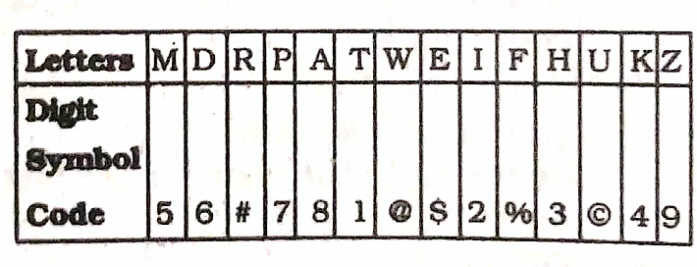
Conditions:
(a) If the first letter is consonants and the last letter is vowel their codes are to be inter changed.
(b) If both the first and the last letters are vowels, both are to be coded as *.
(c) If the first letter is a vowel and the last letter is consonant, Both are to be coded as the code for the consonant.
19. TUKDIP (l) 1©4627 (2) 1©4621 (3) 7©4621 (4) 1©6427 (5) None of these
20. EFDMKA (1) $%6548 (2) $%654$ (3) *%654* (4) 8%6548 (5) None of these
21. APWTUH (1) *7@1©* (2) 87@1©3 (3) 37@1©8 (4) 87@1©8 (5) None of these
22.MARTWE.(l) 58#1@$ (2) 58#1@5 (3) $8#1@5 (4) $8#1@9 (5) None of these
23. HEMKZI (1) 2$5493 (2) 3#5492 (3) 3$5493 (4) 2$5492 (5) None of these

Slide 9
24.If ‘white’ called ‘black’: ‘black’ called ‘red’; ‘red’ called ‘blue’, ‘blue’ called ‘yellow’ and ‘yellow‘ called ‘grey', then which of the following represents the colour of clear sky ?
(1) blue (2) red (3) yellow (4) Cannot be determined (5) None of these

Slide 10
THANK YOU

